Slide 1

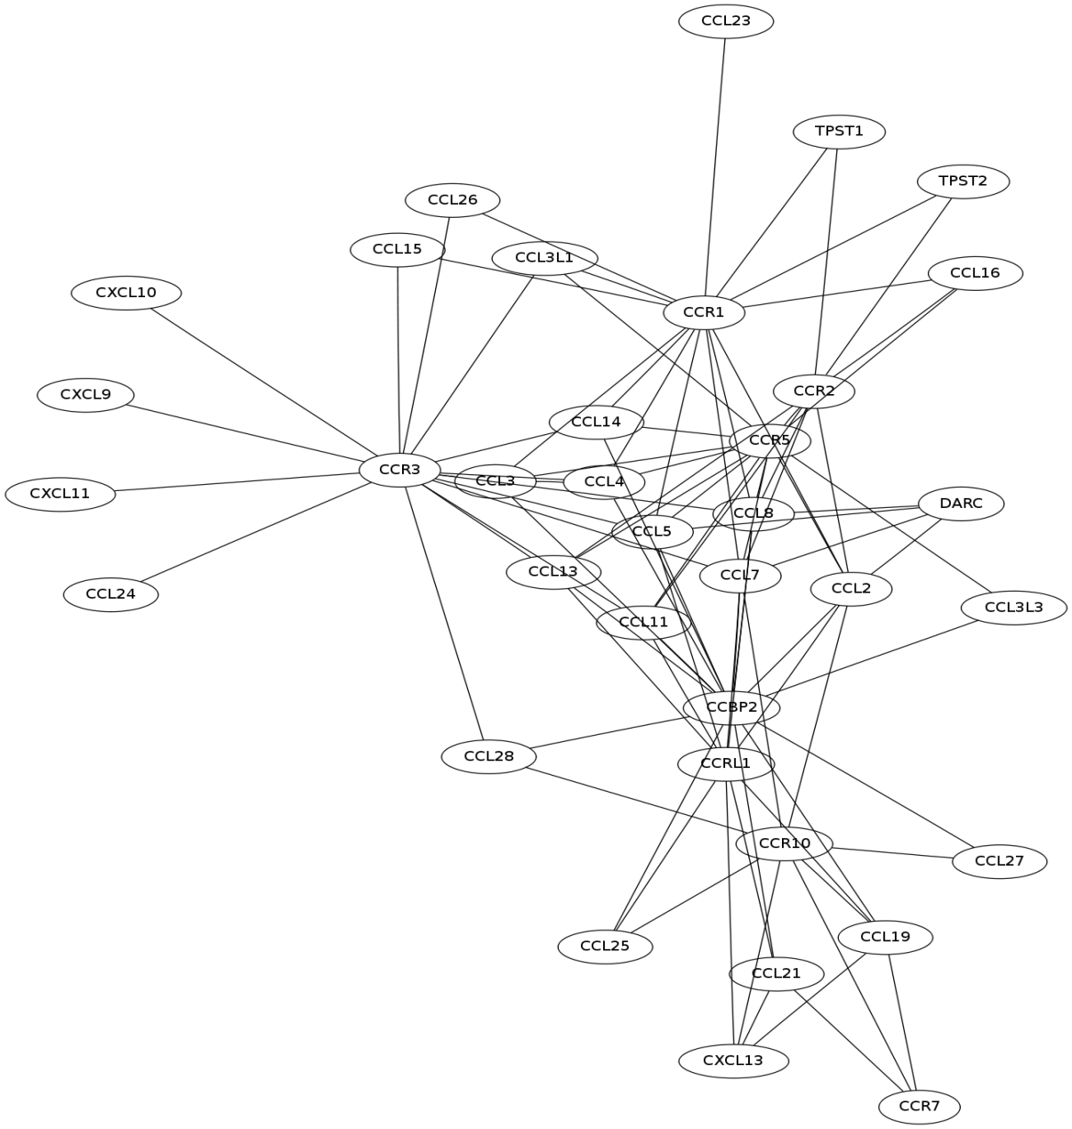
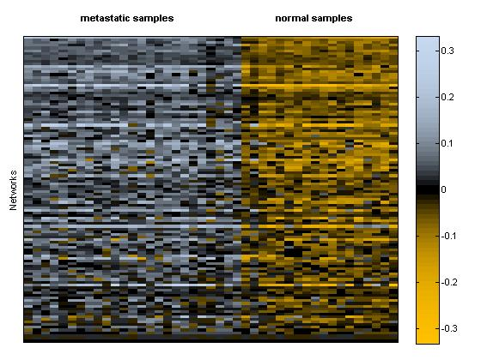
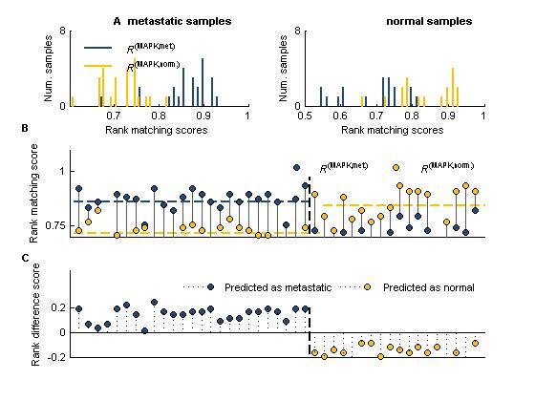
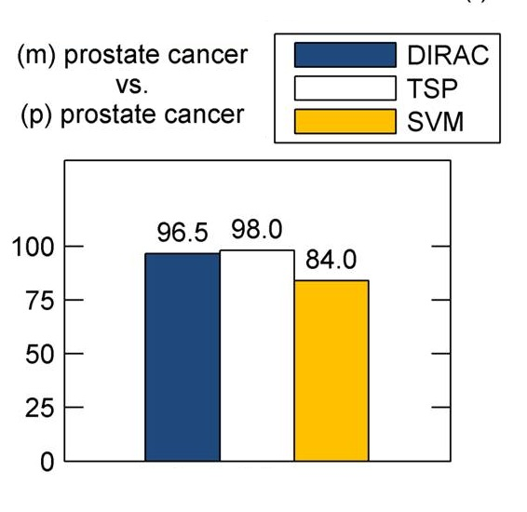
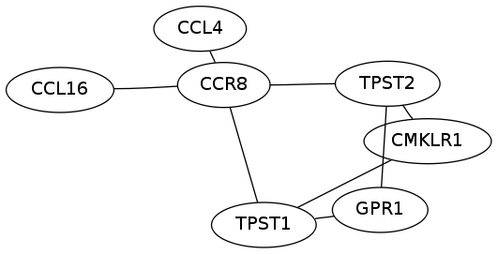
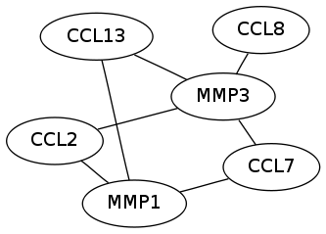
Diagnostic Disease-Perturbed Biomolecular Networks
in Prostate Cancer
Bobak Hadidi, James A. Eddy, Nathan D. Price
Department of Computer Science
---
Department of Bioengineering
---
Department of Chemical & Biomolecular Engineering
---
Institute for Genomic Biology
Background
DIRAC for pathway-based gene expression analysis
Variably expressed pathways in prostate cancer
Cancer is a multi-genic disease that arises from perturbations to a number of key biomolecular networks. The identity and key components of these networks are often not all known and can vary significantly between cancers. Thus is it critical to develop approaches that can operate on available high-throughput data to better distinguish such networks and the sets of interlinked components comprising them. Our approach can identify highly disease-perturbed networks with phenotype-diagnosing capacity.
Differential Rank Conservation (DIRAC) is a novel approach for studying gene expression within pathways, based on the relative expression values of participating genes – i.e., the ordering of expression within samples.
At the sample level, we use rank difference scores (Δ) to identify variably expressed pathways between phenotypes.
A family of cytokine receptors and associated ligands identified as a candidate network by link community clustering over PPI data.
Rank difference scores between normal and metastatic prostate cancer in all generated networks
Our approach
Protein-protein interaction (PPI) information is obtained from public, manually curated databases including the Biological General Repository for Interaction Datasets (BioGRID), the Human Protein Reference Database (HPRD), and the Database of Interacting Proteins (DIP), and used to construct PPI networks. These PPI networks serve as inputs to the computational analyses used here.
Overview of DIRAC methods
Variably expressed pathways identified by DIRAC are highly accurate classifiers and represent statistically robust differences between disease states.
Classification with DIRAC
High-throughput data repository
Phenotype-labeled microarray gene expression data
Predefined candidate networks, i.e. Biocarta pathways
DIRAC-based classification of expression profiles (metastatic prostate cancer or normal) within cross validation compares favorably to other state-of-the-art classification methods – including the top-scoring pair (TSP) algorithm and support vector machines (SVM).
BioGRID HPRD DIP
DIRAC
Protein-protein interactions
Clustered
candidate networks
Normal vs. Metastatic
Prostate Cancer
Cross validation accuracies
Identify sub-networks in global PPI graph
Link Communities
Highly perturbed networks accurately distinguish phenotypes and define potential biomarkers of disease
Clustering through link communities
Link Communities is a hierarchical clustering method based on the similarity of links rather than nodes in the graph. In the resulting dendrogram, nodes may occupy multiple agglomerations due to their links.
Evaluation of candidate networks
S(e_{ab} , e_{bc}) = |n₊(a) ∩ n₊(c)| / |n₊(a) U n₊(c) |
Conclusions
How do the generated networks compare to predefined pathways via Biocarta?
The similarity measure between two edges, where n₊(i) denotes the set of neighbors of I, inclusive of i.
Top 5 most variably expressed pathways in normal vs. metastatic prostate cancer and coinciding link community
Disease-perturbed biomolecular networks present a powerful and unique diagnosis opportunity. DIRAC, in conjunction with novel clustering techniques, can realize the benefits afforded by this, even without predefined biological pathways or networks to be scrutinized.
Further work is required to examine the breadth and depth of applicability.
Source Database | Nodes | Links | Nontrivial* Communities Found
BioGRID | 39476 | 744469 | >10000
Human Protein Reference DB | 9374 | 38534 | 3965
Database of Interacting Proteins | 2673 | 8615 | 733
Combined | 41821 | 770655 | >10000
Pathway | # Genes | # Gene pairs | Template ∆ | P-value | Closest Link Comm. # Genes | Jaccard Coefficient
Fibrinolysis (Clotting/Coagulation) | 12 | 66 | 0.1557 | 0 | 4 | 0.3333
Extrinsic Prothrombin (Clotting/Coagulation) | 12 | 66 | 0.1546 | 0 | 19 | 0.2308
Intrinsic Prothrombin (Clotting/Coagulation) | 22 | 231 | 0.1351 | 2.42e-05 | 8 | 0.2400
Classic Complement (Foreign Cell Defense) | 10 | 45 | 0.1003 | 3.55e-04 | 2 | 0.1429
Terc (Telomerase Regulation) | 6 | 15 | 0.0907 | 6.65e-04 | 3 | 0.5000
Links are interactions between gene products. Both generated networks share elements of the larger cytokine receptor network. The mutual molecules have disparate roles in either network.
References
*The community must contain at least three nodes
Eddy JA, Hood L, Price ND, Geman D (2010) Identifying Tightly Regulated and Variably Expressed Networks by Differential Rank Conservation (DIRAC). PLoS Comp Biol, In Press.
Ahn Y, Bagrow JP, Lehmann S (2009) Link Communities Reveal Multi-scale Complexity in Networks. arXiv:0903.3178.

